Slide 2
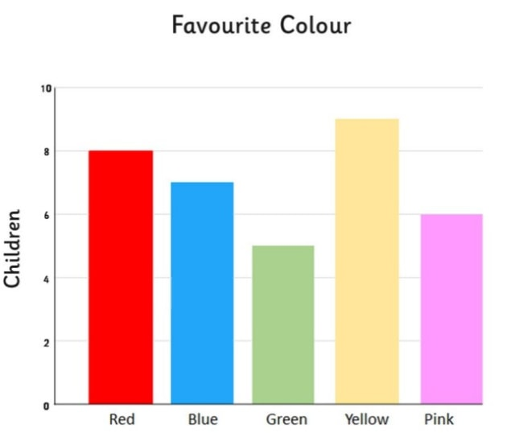

Slide 3
R - Bar Charts
A bar chart represents data in rectangular bars with length of the bar proportional to the value of the variable.
R uses the function barplot() to create bar charts. R can draw both vertical and Horizontal bars in the bar chart.
In bar chart each of the bars can be given different colors.

Slide 4
Syntax
The basic syntax to create a bar-chart in R is −
barplot(H,xlab,ylab,main, names.arg,col)

Slide 5
Following is the description of the parameters used −
H is a vector or matrix containing numeric values used in bar chart.
xlab is the label for x axis.
ylab is the label for y axis.
main is the title of the bar chart.
names.arg is a vector of names appearing under each bar.
col is used to give colors to the bars in the graph.

Slide 6
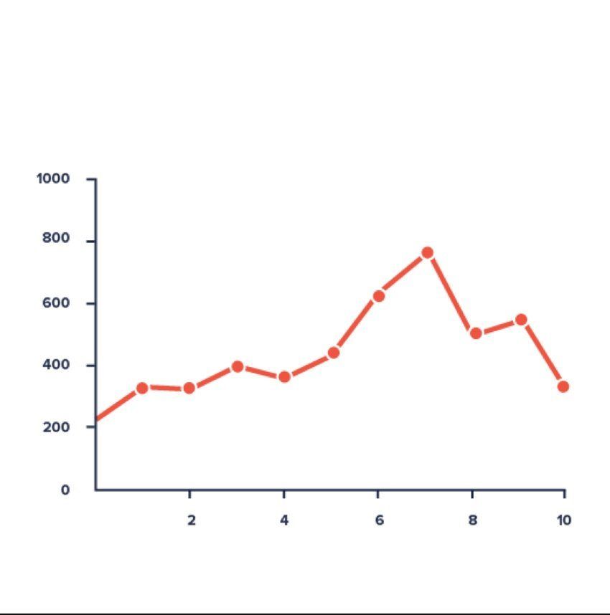

Slide 7
R - Line Graphs
A line chart is a graph that connects a series of points by drawing line segments between them.

Slide 8
Syntax
The basic syntax to create a line chart in R is −
plot(v,type,col,xlab,ylab)

Slide 9
Following is the description of the parameters used −
v is a vector containing the numeric values.
type takes the value "p" to draw only the points, "l" to draw only the lines and "o" to draw both points and lines.
xlab is the label for x axis.
ylab is the label for y axis.
main is the Title of the chart.
col is used to give colors to both the points and lines.

Slide 10
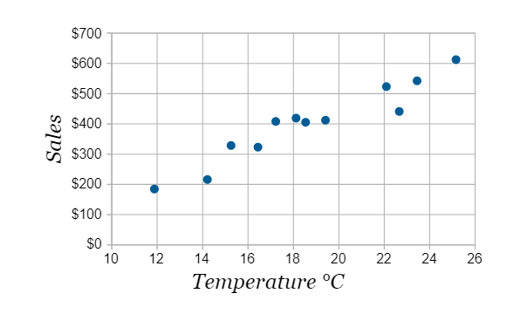

Slide 11
Scatterplots show many points plotted in the Cartesian plane. Each point represents the values of two variables. One variable is chosen in the horizontal axis and another in the vertical axis.
The simple scatterplot is created using the plot() function.

Slide 12
Syntax
The basic syntax for creating scatterplot in R is −
plot(x, y, main, xlab, ylab, xlim, ylim)

Slide 13
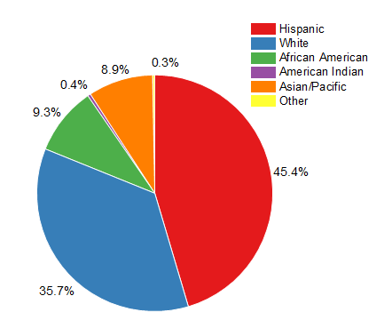

Slide 14
R - Pie Charts
In R the pie chart is created using the pie() function which takes positive numbers as a vector input. The additional parameters are used to control labels, color, title etc.

